Slide 1
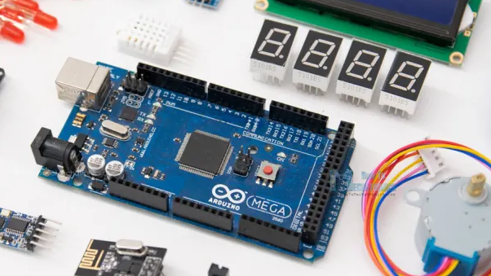
ARDUINO-BASED CAR PARKING SYSTEM
GROUP 1
BALLA
CICAT
FABRO

Slide 2
INTRODUCTION
ARDUINO-BASED CAR PARKING SYSTEM
By implementing a Car Parking System with Arduino, this project offers a practical solution to address the challenges of urban parking, improving efficiency, reducing traffic congestion, optimizing parking space utilization, and providing convenience for drivers and parking lot operators.

Slide 3

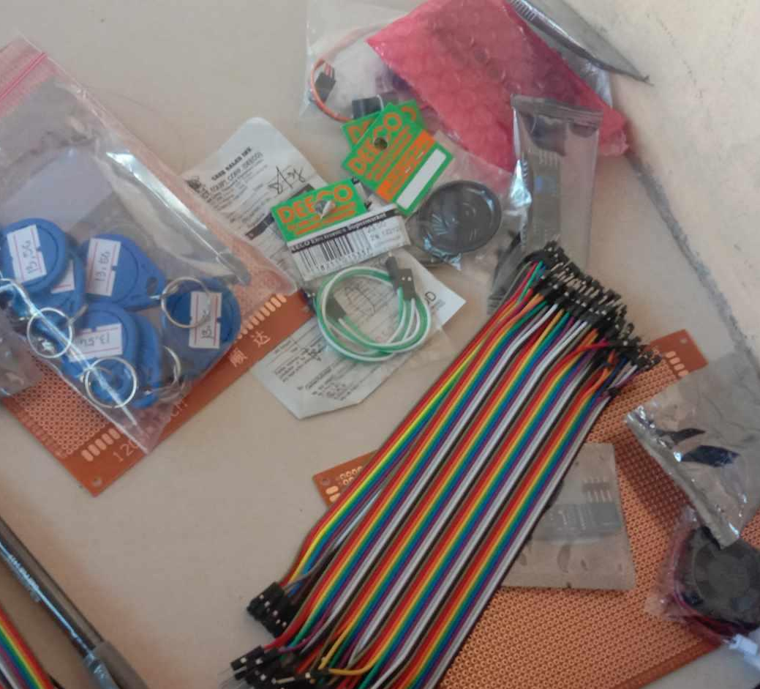

PROTOTYPE AND PROJECT DOCUMENTATION
PICTURE

Slide 4
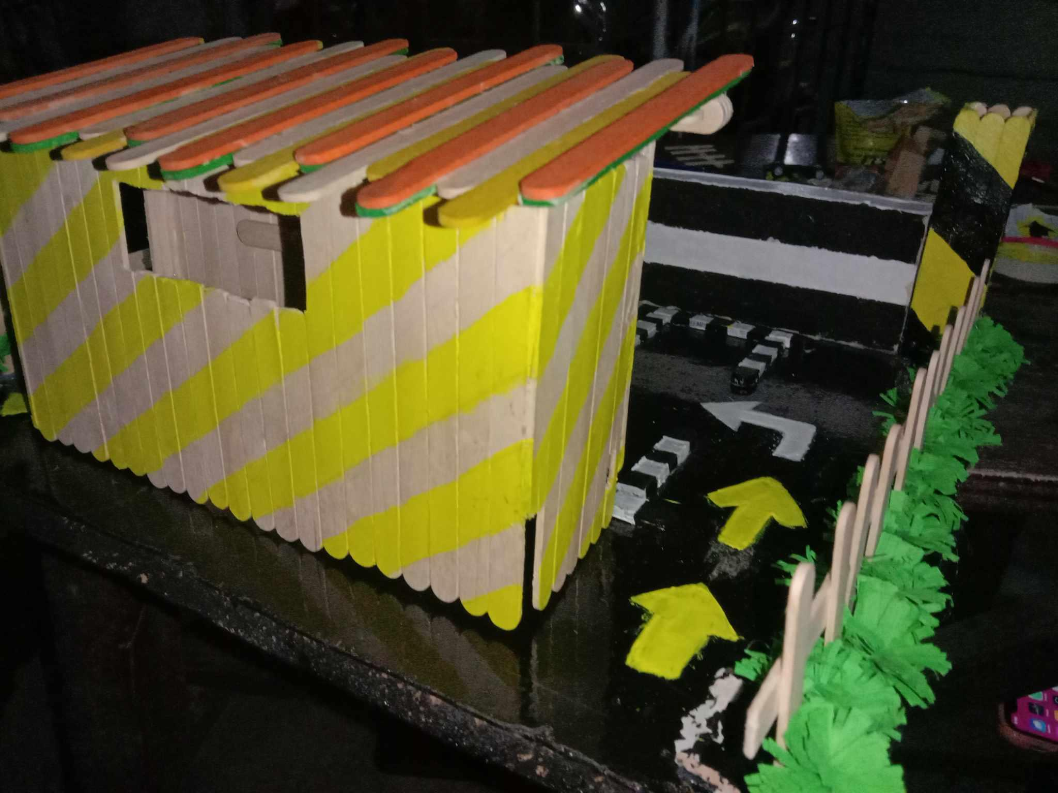
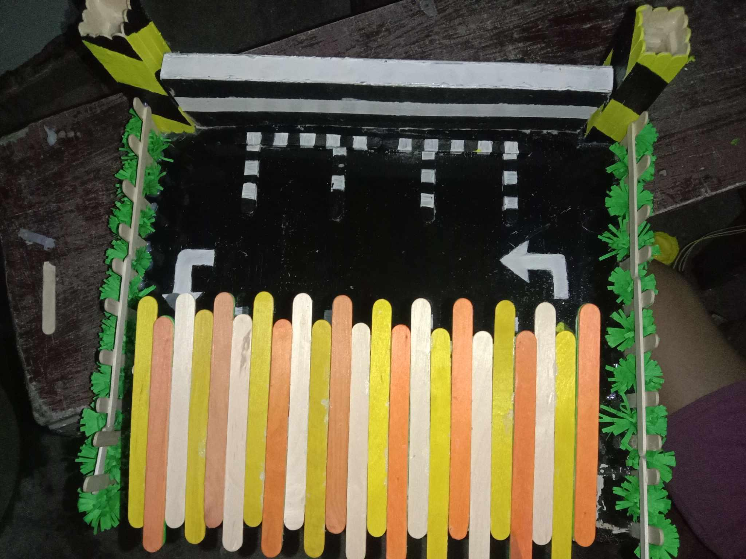
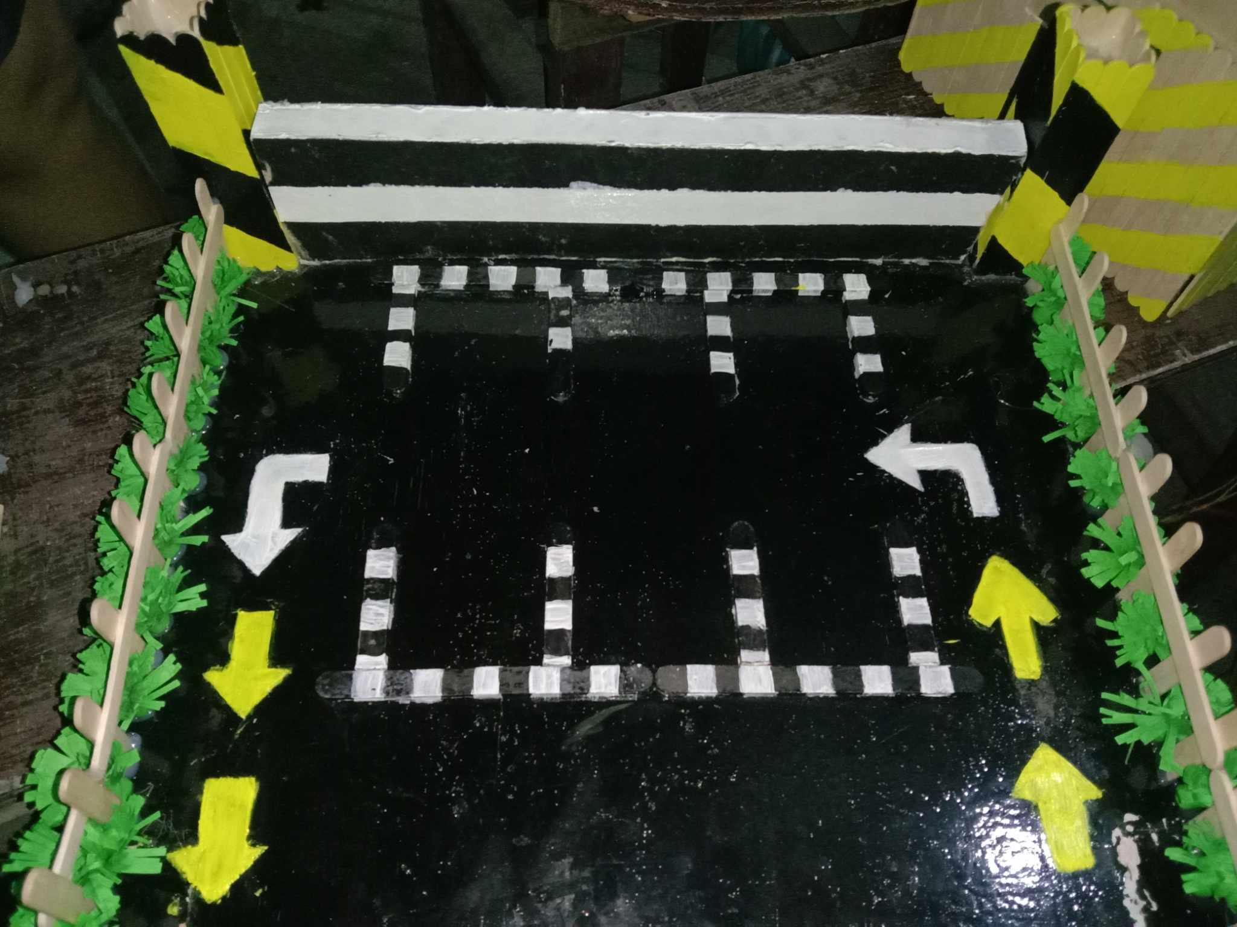
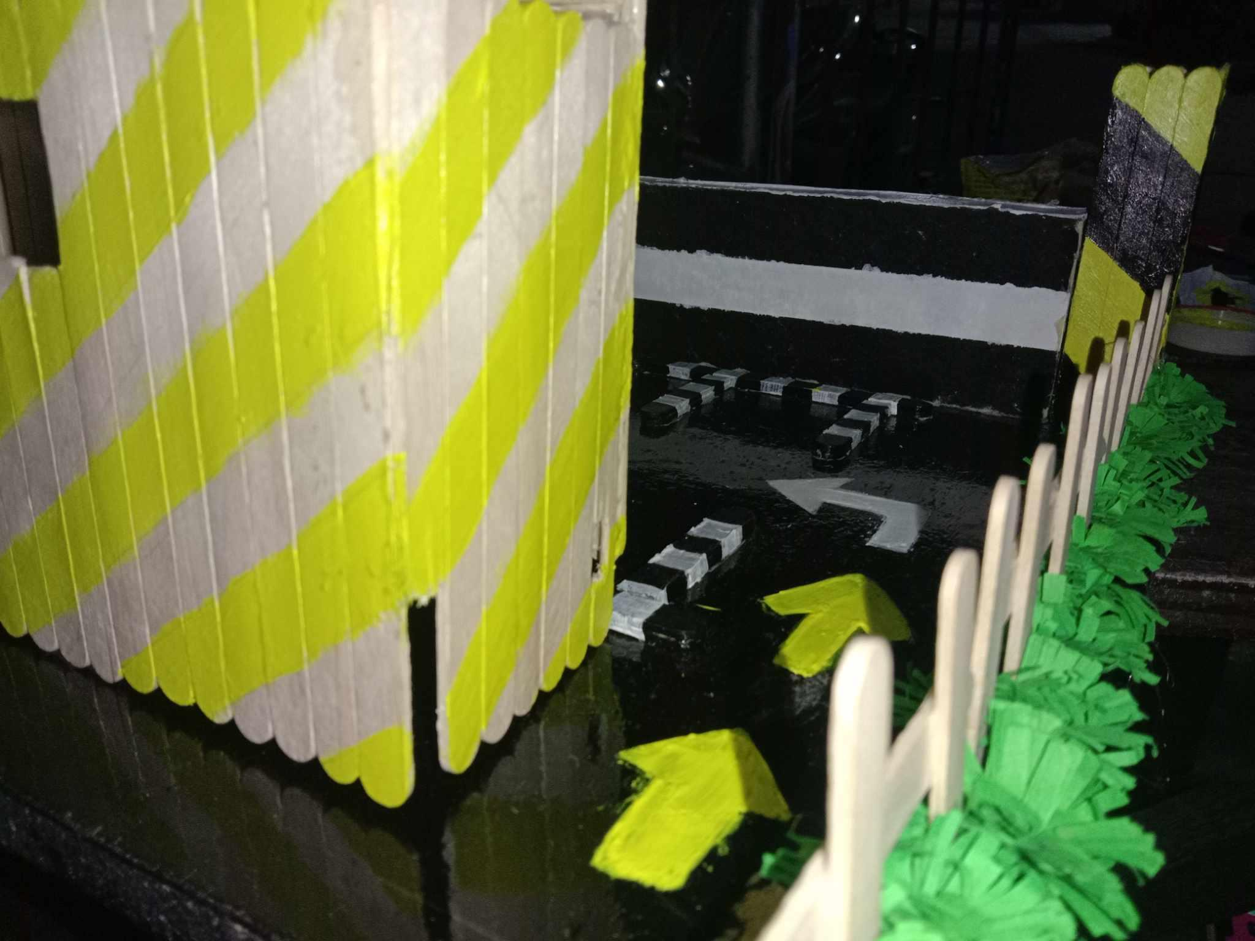
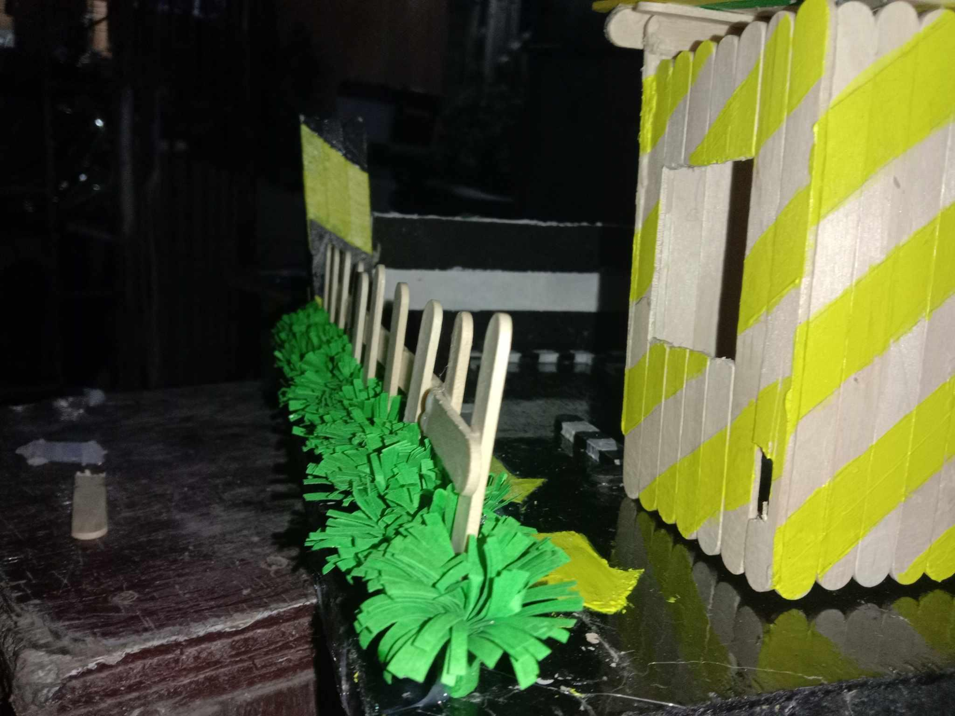
PROTOTYPE AND PROJECT DOCUMENTATION

Slide 5
COMPONENTS OF THE PROJECT

Slide 6

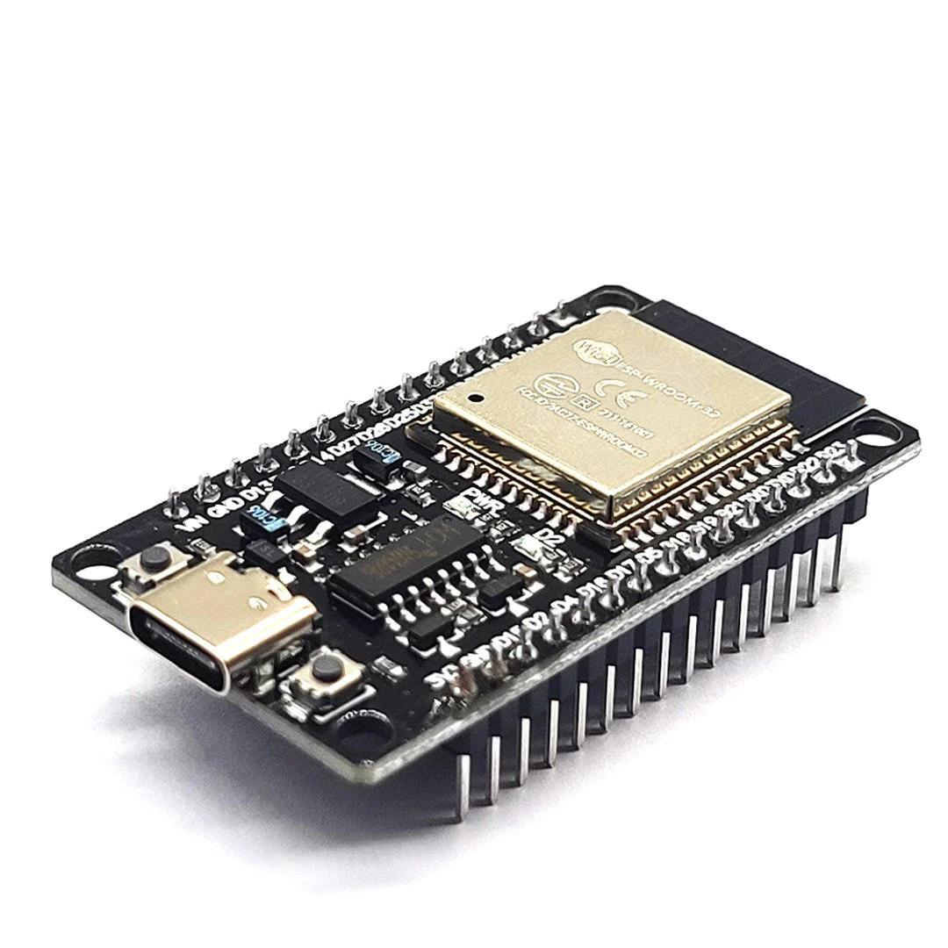
ESP WROOM 32

Slide 7
ESP WROOM 32
COMPONENTS
The ESP-WROOM-32 is a powerful and versatile Wi-Fi and Bluetooth module developed by Espressif Systems. It's built around the ESP32 chip, which is a highly integrated SoC (System on Chip) featuring dual-core processors, Wi-Fi and Bluetooth connectivity, along with a wide range of peripheral interfaces.

Slide 8
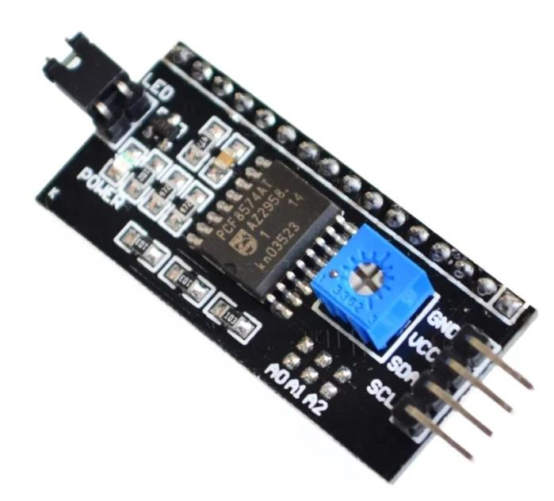
I2C MODULE

Slide 9
I2C MODULE
COMPONENTS
The I2C (Inter-Integrated Circuit) module is a communication protocol commonly used in electronics and IoT projects. It enables communication between integrated circuits, microcontrollers, and peripheral devices using a simple, two-wire serial interface.

Slide 10
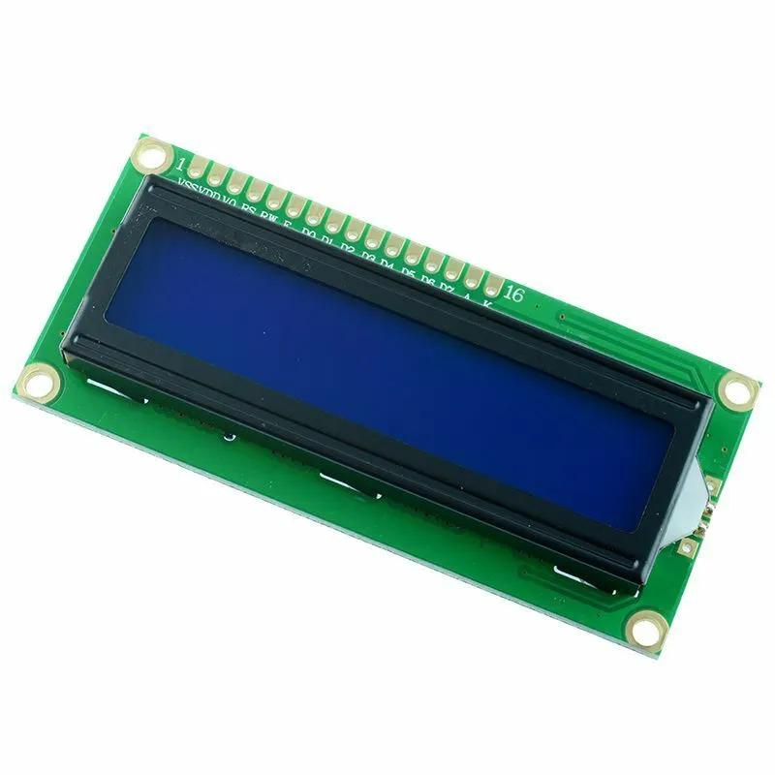
LCD DISPLAY

Slide 11
LCD DISPLAY
COMPONENTS
An LCD (Liquid Crystal Display) is a flat panel display technology that uses liquid crystals to produce images. LCD displays are commonly used in a wide range of electronic devices, including smartphones, computer monitors, televisions, and various IoT (Internet of Things) projects.

Slide 12
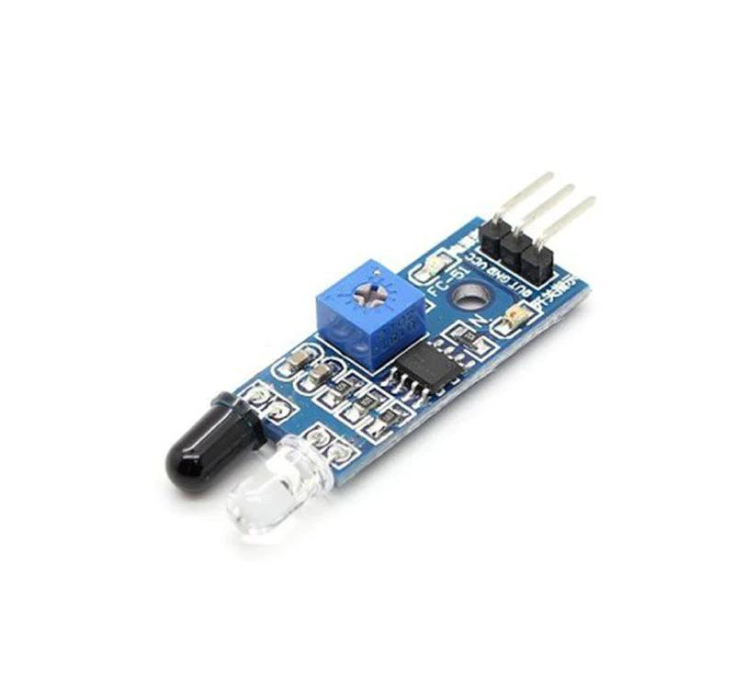
INFRARED SENSOR

Slide 13
INFRARED SENSOR
COMPONENTS
An IR (Infrared) sensor is a device that detects infrared radiation in its surrounding environment. It is a type of electromagnetic radiation that is invisible to the human eye but can be sensed by electronic devices. These are commonly used in various applications due to their versatility and effectiveness in detecting motion, proximity, and temperature changes.

Slide 14
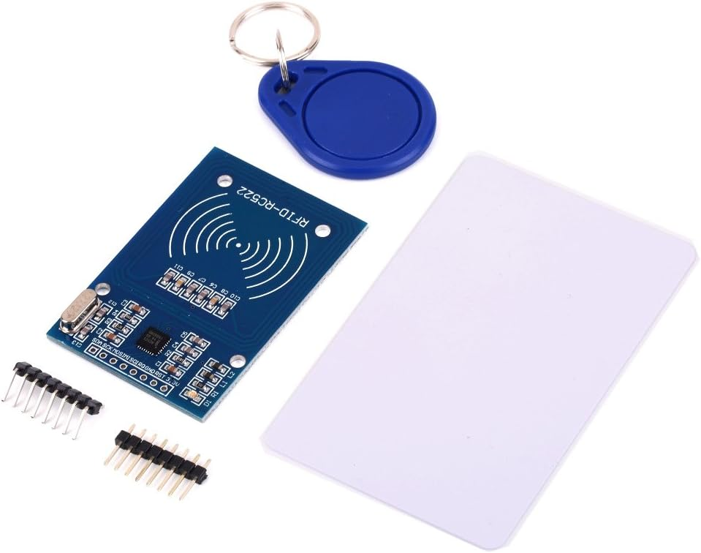
RFID READER

Slide 15
RFID READER/SENSOR
COMPONENTS
RFID (Radio-Frequency Identification) reader/sensor is a device that uses radio-frequency electromagnetic fields to automatically identify and track tags attached to objects. These tags contain electronically stored information, which can be read by an RFID reader.

Slide 16
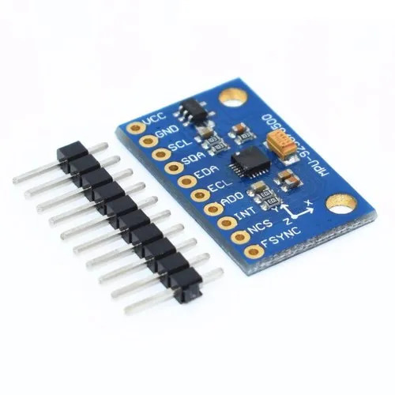
ACCELEROMETER SENSOR

Slide 17
ACCELEROMETER SENSOR
COMPONENTS
An accelerometer sensor is a device that measures proper acceleration, which is the acceleration experienced relative to free fall. In simpler terms, it measures the rate of change of velocity of an object in motion. It is commonly used in various applications, including smartphones, wearables, automotive systems, aerospace technology, and, notably, in IoT projects.

Slide 18
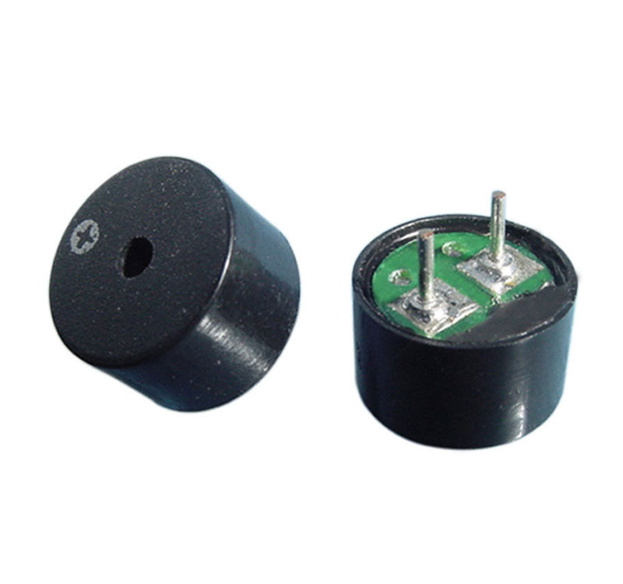
BUZZERS

Slide 19
BUZZERS
COMPONENTS
Buzzers are simple audio output devices that produce a buzzing or beeping sound when activated and often used to provide alerts, notifications, or alarms when specific conditions are met. For example, a buzzer might sound when a motion sensor detects movement or when a door sensor detects unauthorized access.

Slide 20
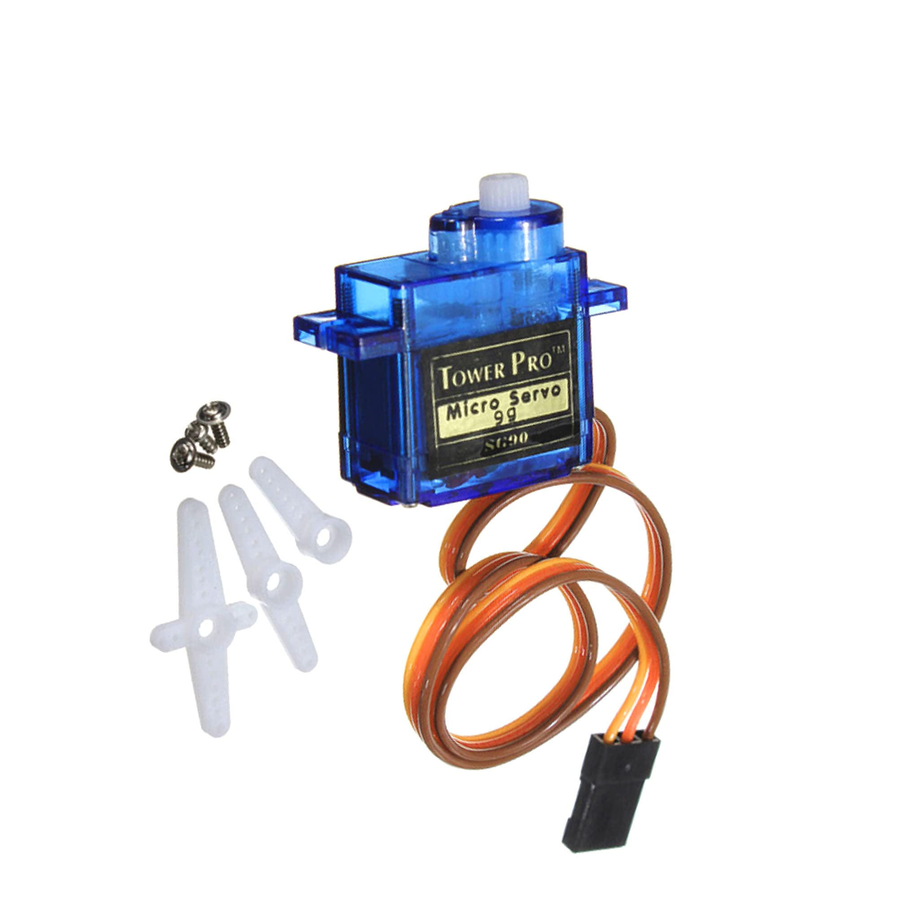
SERVO MOTOR

Slide 21
SERVO MOTOR
COMPONENTS
A servo motor is a type of motor that is used to precisely control position, speed, and acceleration in various applications. It operates based on the principle of feedback control, where the motor's position or velocity is continuously monitored and adjusted to achieve the desired output.

Slide 22
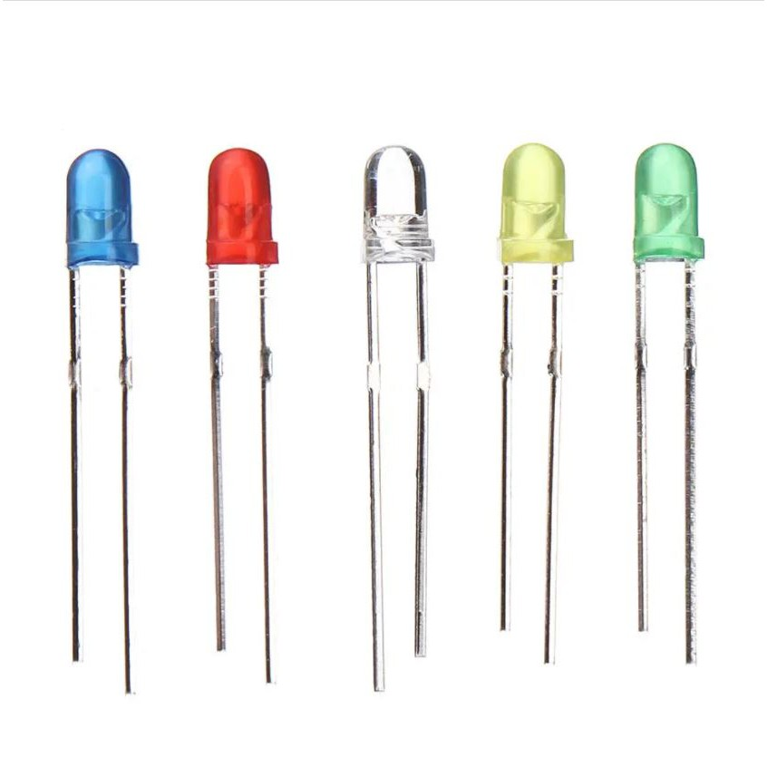
LED LIGHTS

Slide 23
LED LIGHTS
COMPONENTS
Light Emitting Diodes (LEDs) serve a multitude of purposes across various fields, owing to their efficiency, versatility, and longevity. One of the primary uses of LED lights is in illumination, where they have become increasingly popular due to their energy efficiency and long lifespan compared to traditional incandescent or fluorescent lighting sources. It is employed in a wide range of applications, from residential and commercial lighting to automotive and street lighting, offering bright and uniform illumination while consuming significantly less power.

Slide 24
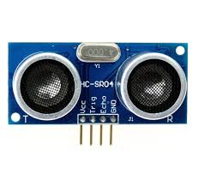
ULTRASONIC SENSOR

Slide 25
ULTRASONIC SENSOR
COMPONENTS
Ultrasonic Sensor measures distance or detect the presence of objects without physical contact. It emits high-frequency sound waves and measures the time it takes for the waves to bounce back after hitting an object. This data is then used to calculate distance, enabling applications such as obstacle detection, liquid level measurement, presence sensing, proximity detection, and flow rate measurement.

Slide 26
WIFI AND BLUETOOTH OF ESP32
WIFI INTERNET CONNECTIVITY: THE ESP32 CAN CONNECT TO WI-FI NETWORKS, ENABLING IT TO ACCESS THE INTERNET. THIS ALLOWS IT TO FETCH DATA FROM WEB SERVERS, SEND DATA TO CLOUD SERVICES, OR COMMUNICATE WITH OTHER DEVICES OVER THE INTERNET.
IOT APPLICATIONS: WITH WI-FI CONNECTIVITY, THE ESP32 CAN BE USED IN VARIOUS IOT APPLICATIONS SUCH AS HOME AUTOMATION, SMART AGRICULTURE, INDUSTRIAL MONITORING, AND MORE. IT CAN COLLECT DATA FROM SENSORS AND ACTUATORS AND SEND/RECEIVE COMMANDS OVER WI-FI NETWORKS.
BLUETOOTH
WIRELESS COMMUNICATION: TO COMMUNICATE WIRELESSLY WITH OTHER BLUETOOTH-ENABLED DEVICES SUCH AS SMARTPHONES, TABLETS, OTHER MICROCONTROLLERS, SENSORS, AND PERIPHERALS.
BLE (BLUETOOTH LOW ENERGY): THE ESP32 SUPPORTS BLE, WHICH IS PARTICULARLY USEFUL FOR LOW-POWER APPLICATIONS WHERE ENERGY EFFICIENCY IS CRUCIAL, SUCH AS WEARABLES, HEALTH MONITORING DEVICES, AND BEACON TECHNOLOGY.

Slide 27
INPUTS 1. ACCELEROMETER SENSORS CAN DETECT MOVEMENTS, POTENTIALLY INDICATING IF A VEHICLE IS BEING TAMPERED WITH OR IF AN UNAUTHORIZED ATTEMPT IS MADE TO MOVE IT. 2. INFRARED SENSORS MONITORS THE ENTRY AND EXIT OF VEHICLES. 3. RFID READER FOR USER AUTHENTICATION AND ACCESS CONTROL (PAYMENT OF THE USERS CAN ALSO WRITE AND READ THE USE INFORMATION) 4. ULTRASONIC SENSORS PROVIDES A NON-CONTACT AND ACCURATE MEASUREMENT OF DISTANCE, SPEED, PRESENCE, OR OTHER PARAMETERS IN VARIOUS APPLICATIONS.

Slide 28
OUTPUTS 1. LCD DISPLAY FOR SHOWING AVAILABLE PARKING SPOTS AND USER INSTRUCTIONS. 2. BUZZER INDICATOR OF ENTERING AND EXITING THE PARKING LOT. 3. SERVO MOTORS FOR AUTOMATED BARRIER CONTROL AT ENTRY AND EXIT POINTS. 4. LED LIGHTS PROVIDES FEEDBACK AND STATUS INDICATION TO ENHANCE USER INTERACTION AND AESTHETIC APPEAL. OUTPUTS RED IF THE VEHICLE IS OVER SPEEDING OTHERWISE BLUE.

Slide 29
THE PRICE RANGE FOR PARKING SPACES CAN BE CUSTOMIZED BASED ON FACTORS SUCH AS LOCATION, DEMAND, AND DURATION OF PARKING. BLUETOOTH CONNECTIVITY ENABLES REAL-TIME INFORMATION BETWEEN THE PARKING SYSTEM AND USERS' MOBILE DEVICE, AND RELEVANT NOTIFICATIONS. NOTIFICATION AS HOURS INTERVAL BETWEEN ENTRY AND EXITING AND HOW MUCH IS THE PAYMENT OF PARKING. WI-FI CONNECTIVITY, CONNECTS THE ARDUINO BOARD TO A WI-FI NETWORK USING THE PROVIDED SSID AND PASSWORD. ONCE CONNECTED, IT DISPLAYS THE LOCAL IP ADDRESS TO THE SERIAL LCD.

